Slide 1
Mucking About with Google AIY Voice
FDE South Spring Event
TNMOC 26/02/2018
Nick Cross, Jon Funiciello, Caroline Knight, Nick Parlow

Slide 2
Introduction
PTSG Stevenage
We Fix Stuff
We Teach Stuff
We Automate Stuff

Slide 3
What We’re Going To Do
We’re going to talk about stuff – Raspberry Pi, Google AIY, APIs, Voice HAT
We’re going to demo some stuff
You’re going to make some stuff
You’re going to talk to each other about it.

Slide 4
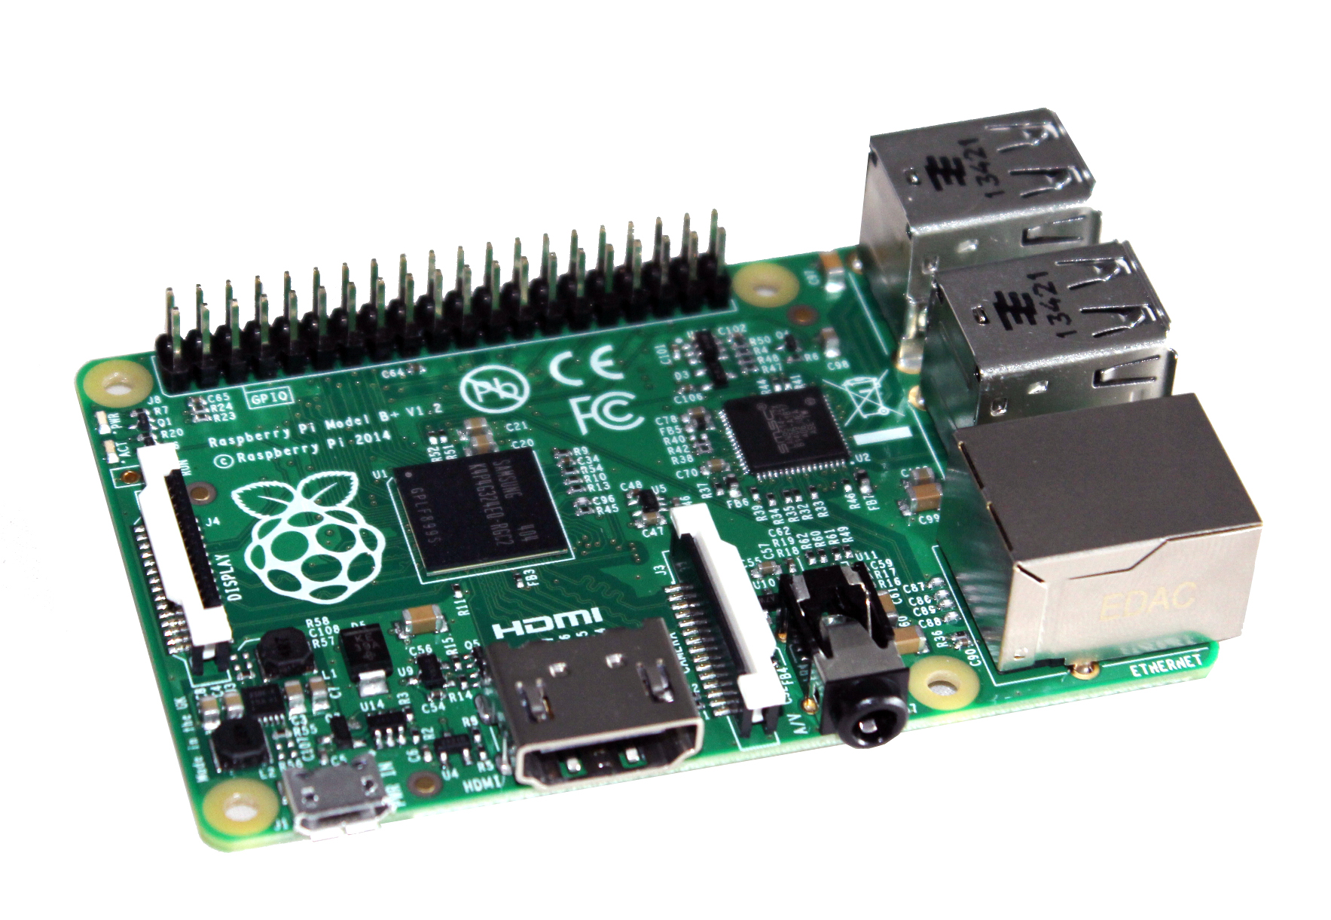
Raspberry Pi
Small cheap microcomputer
1GB RAM
Runs Raspbian (Debian)
Likes Python
Notes:
Hands up who knows about the raspberypi? Debian? Python?
1GB of RAM so watch the number of tabs you have open in chromium – it may grind completely to a halt.
If you’re not familiar with debian or other linux distro, don’t worry, neither am I. Likewise python. Nick cross can help when you’re trying to get stuff working.
Can be extended by adding HATs – hardware attached on tyop, or just grabbing pinsd on the GPIO strip.

Slide 5
Google AIY
Released June 2017
FREE! (for magpi subscribers)
VoiceHAT, microphone, enclosure, big friendly button

Slide 6
assistant_library_demo.py
Starts the assistant listening for hotword (ok google)
Demostrates basic functionality of the assistant.
Notes:
Uses the following modules from /src/aiy
Aiy.assistant.auth_helpers
Aiy.vociehat
And the google.assistnat.ibrary
Auth helpers isfor authentication (unsurprisingly)
Voicehat provides three functions – get_button, get_led and get_status

Slide 7
assistant_grpc_demo.py
gRPC = open source RPC system developed by Google
This code uses an external trigger to start he assistant running, rather than having the assistant listening all the time
Notes:
Uses the following apis provided in src/aiy:
Aiy.audio
Aiy.assistant.grpc
Aiy.voicehat
A nd
Google.assistant.library

Slide 8
assistant_library_demo.py

Slide 9
assistant_library_demo.py

Slide 10
Google AIY
Released June 2017
FREE! (for magpi subscribers)
VoiceHAT, microphone, enclosure, big friendly button

